Slide 1
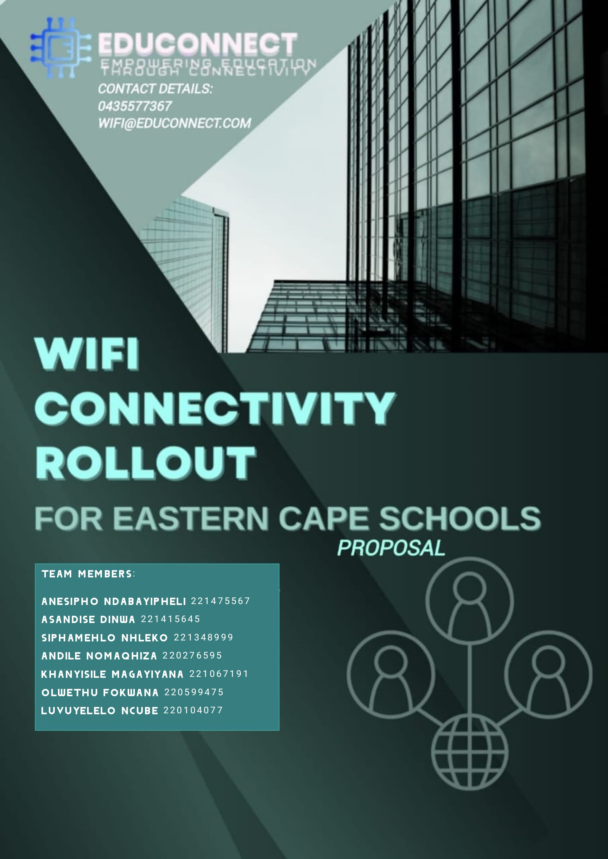

Slide 2
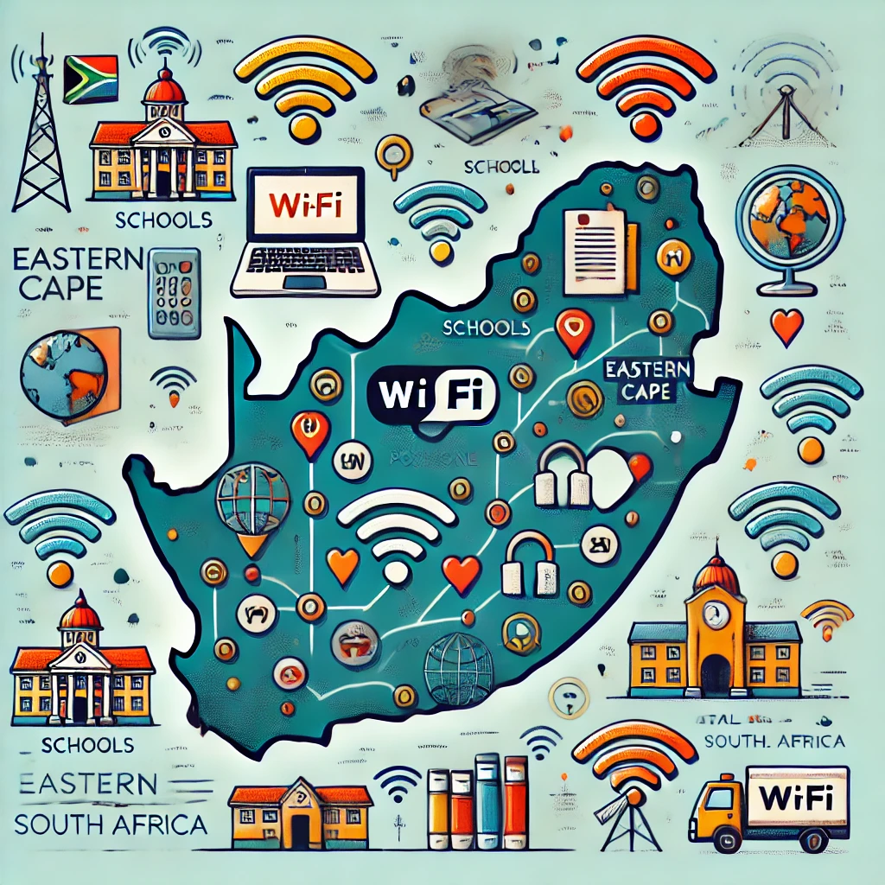
Executive Summary
Key Points:
- Addressing the need for reliable internet in schools
- Rolling out Wi-Fi across the Eastern Cape Province
- Tools for teachers and students to support modern learning
- Project success measured by linked schools, satisfaction scores, and student digital literacy.

Slide 3
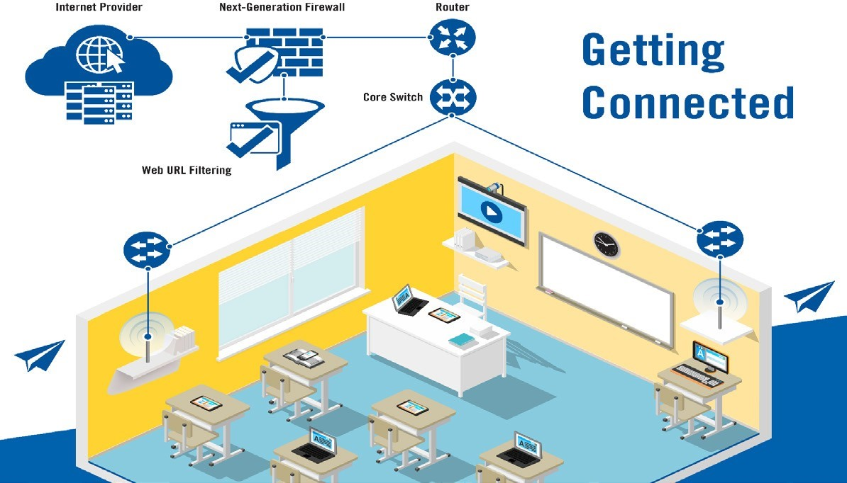
Specific Objectives: - Safe and fast Wi-Fi for all public schools - Easy access to the "Umfundisi Wezinto" educational server - A scalable, reliable, and maintainable network solution

Slide 4
Problem Identification - Problem: Gaps in digital learning due to inconsistent Wi-Fi - Solution: Providing long-term Wi-Fi access to all schools

Slide 5
Project Scope
In Scope:
Wi-Fi installation in all schools
Internet access and educational server connection
Out of Scope:
Development of custom educational software
Provision of student devices

Slide 6
Appropriate ways to measure the success of a project :
Quality of deliverables
Stakeholder satisfaction
Budget adherence
Achievement of project objectives
Schedule adherence
Return on investment (ROI)
Lessons learnt and continuos improvement
KEY TECHNICAL SKILLLS
Design and management of network infrastructure
Internet connectivitity provision
Cyber security
IT support and help desk services
Integration of educational technologies

Slide 7
Expected Benefits & Dis-Benefits
Benefits:
Increased access to information
Improved educational results
Bridging the digital divide
Preparation for a digital world
Dis-benefits:
Costs and sustainability
Cybersecurity and information overload
Potential distractions

Slide 8
Estimated Costs
Urban Areas: R3 000 000 – R3 500 000
Rural Areas: R9 675 000 – R10 300 000
Factors needed to considered :
Number of schools
Internet Service provider(ISP) Costs
Infrastructure Requirements
Hardware Costs
Training and Support
Maintanance and Upgrades

Slide 9
Major Risks & Compliance
- Technical failure
- Budget overruns
- Resistance to change
- Cybersecurity threats
- BBBEE status level
- Disclosure of interest
- POPIA

Slide 10

Conclusion:
- Wi-Fi rollout will bridge the digital divide, enhance educational results, and foster digital literacy across the Eastern Cape.
- Collaborative efforts with stakeholders will ensure successful implementation.

